Slide 1
Monthly Performance Metrics: Requests, Resolutions, Revenue, and New Businesses
By Alero giwa osagie

Slide 2
the primary objectives
Understand and analyze the relationship between total requests received and total revenue generated
Examine the distribution of new businesses incepted across different months
Assess the resolution rate to evaluate the efficiency of handling customer requests
Explore revenue trends for each month to identify patterns or seasonal variations
Provide actionable insights to stakeholders based on the data analysis

Slide 3
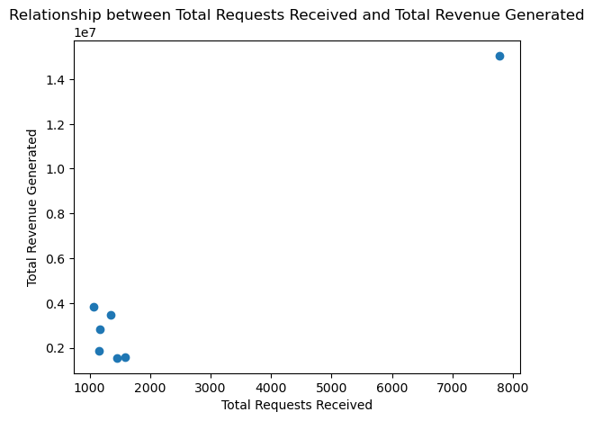
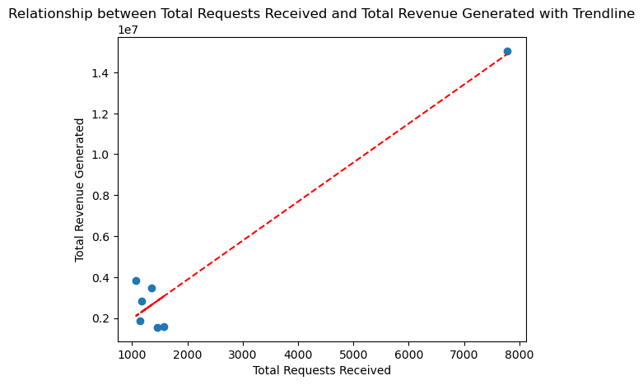
Understand and analyze the relationship between total requests received and total revenue generated
Relationship between Total Requests Received and Total Revenue Generated
Relationship between Total Requests Received and Total Revenue Generated with Trendline

Slide 4
The analysis focused on understanding the relationship between the total number of customer requests received and the revenue generated.
Key findings include:
Average Revenue per Request: On average, each customer request contributes a certain amount of revenue. This helps us understand the value of individual requests and the potential revenue they can generate.
Positive Relationship: There is a positive relationship between the number of customer requests received and the revenue generated. As the number of requests increases, so does the revenue. This indicates that our efforts to attract more customer requests are directly impacting our revenue growth.
By recognizing this relationship, we can leverage it to drive business growth. Increasing our customer requests can lead to higher revenue generation. We should focus on converting these requests into revenue-generating opportunities effectively.
These insights highlight the importance of our marketing and sales efforts in attracting more customer requests. By optimizing our strategies to increase customer requests, we have the potential to drive revenue growth and improve overall business performance."

Slide 5
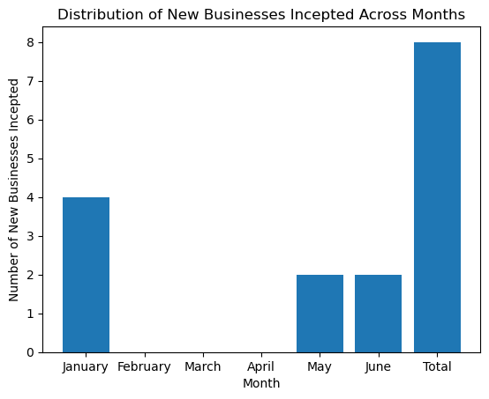
Examine the distribution of new businesses incepted across different months
The bar chart showcases the distribution of new businesses incepted across different months, providing insights into our business acquisition efforts. Key takeaways include:
Varying Monthly Performance: Each month had a different number of new businesses incepted, showing fluctuations in our business acquisition throughout the year.
Successful Months: January stood out as the most successful month, with a high number of new businesses incepted. May and June also performed well, demonstrating significant growth during those periods.
Areas for Improvement: February didn't see any new businesses incepted. This highlights an opportunity for us to understand and address the challenges that hindered new business acquisition during that specific month.
Analyzing the distribution of new businesses incepted helps us evaluate our business acquisition effectiveness. By learning from successful months, we can replicate strategies that contributed to our achievements. Simultaneously, addressing challenges in low-performing months like February allows us to refine our approach and improve future performance.
These insights emphasize the importance of continuous improvement in our business acquisition strategies. By optimizing our efforts, we can attract more new businesses and drive overall growth."

Slide 6
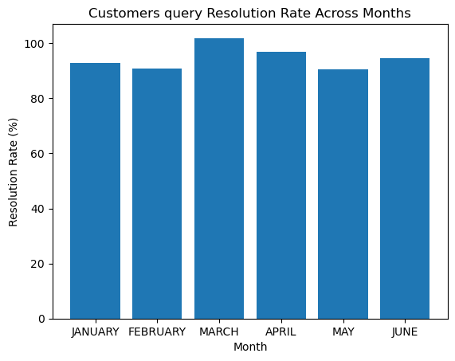
Assess the resolution rate to evaluate the efficiency of handling customer requests
The bar chart shows how well we handle customer requests, represented by the resolution rate. Here's what we can observe:
Resolution Rate Variation: The chart reveals that the resolution rate varies across different months. This indicates how effectively we address customer inquiries and resolve their issues.
Higher Resolution Rates: Some months, like March and April, show higher resolution rates. This suggests that we handle customer requests efficiently during those periods.
Opportunities for Improvement: On the other hand, months like February and May have relatively lower resolution rates. This highlights areas where we can focus on improving our response and resolution processes.
By analyzing the resolution rate, we can evaluate our efficiency in meeting customer needs. We aim to consistently achieve higher resolution rates, as they signify efficient and satisfactory handling of customer requests. This, in turn, leads to increased customer satisfaction and loyalty.
The insights gained from the resolution rate bar chart guide us in identifying areas for improvement and enhancing our overall customer support performance

Slide 7
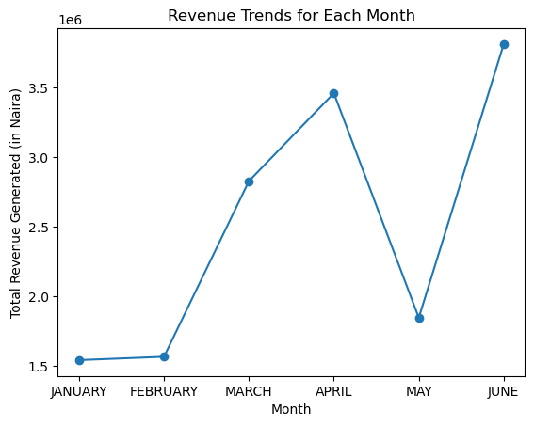
Explore revenue trends for each month to identify patterns or seasonal variations
"The line chart illustrates the revenue trends for each month, providing insights into patterns or seasonal variations. Key observations include:
Revenue Fluctuations: The line shows the fluctuations in revenue across the months, indicating varying levels of business activity.
High and Low Points: Certain months, such as March and June, demonstrate higher revenue levels, while others, like January and May, exhibit comparatively lower revenue.
Seasonal Influences: Analyzing these trends helps us identify any seasonal patterns that may impact revenue. For example, there might be increased demand during specific months or variations due to external factors.
Understanding revenue trends allows us to make informed decisions regarding resource allocation, marketing strategies, and identifying opportunities for revenue growth.
By closely monitoring these patterns and seasonal variations, we can adapt our business strategies to capitalize on peak periods and proactively address any challenges during low-revenue months."

Slide 8
Insights and recommendations
Here are the actionable insights and recommendations:
Focus on peak months: Allocate more resources and marketing efforts during months with higher new businesses incepted, such as January, May, and June, to drive further business growth.
Improve resolution efficiency: Address delays and inefficiencies in resolving customer requests, especially during months with lower resolution rates like February and May. Streamline processes, optimize response times, and enhance training to provide prompt and satisfactory resolutions.
Capitalize on revenue patterns: Identify seasonal variations and patterns in revenue trends. Align marketing campaigns and resource allocation accordingly to maximize revenue during peak months and mitigate challenges during low-revenue months.
Embrace a data-driven culture: Present data-driven insights in a clear and compelling manner to non-technical stakeholders. Encourage the use of data analytics in decision-making, leveraging visualizations and reports to communicate information effectively.
Monitor and adapt: Continuously track key metrics, including customer acquisition, resolution rates, and revenue trends. Evaluate the effectiveness of strategies and make adjustments based on market dynamics and customer needs.
By implementing these insights, stakeholders can make informed decisions, optimize processes, enhance customer satisfaction, and drive business growth.

